Slide 1
SMB Intelligence
SMB Intelligence includes a suite of pre-built, interactive, Dashboard Reports for Dynamics GP that give you a 360-degree view all in one place at the click of a mouse. Improved visibility into your critical business data allows you to make quicker and more informed decisions for your organizations.
There are 5 report modules of available:
Financials
Sales
Purchasing
Inventory
Project Accounting
These modules feature powerful, Data Insights, Data Analytics, Proportional Analysis,
Increase/Decrease Analysis, Question & Answer, and Forecasting (Predictive Analytics)
functionality at the click of a mouse. This functionality is not available in Smart lists, Management Reporter, SSRS, or any Excel-based, third-party reporting product on the market today.
SMB Intelligence is real Business Intelligence, Data Analytics and AI available and affordable for businesses like yours.
If you are a CFO, Controller, Director/Manager of Accounting, CPA or C-Level Executive,
and your data is critical to your decision-making process, schedule a free demo today and see what SMB Intelligence can do for your organization, and take your reporting to a
whole new level.

Slide 2
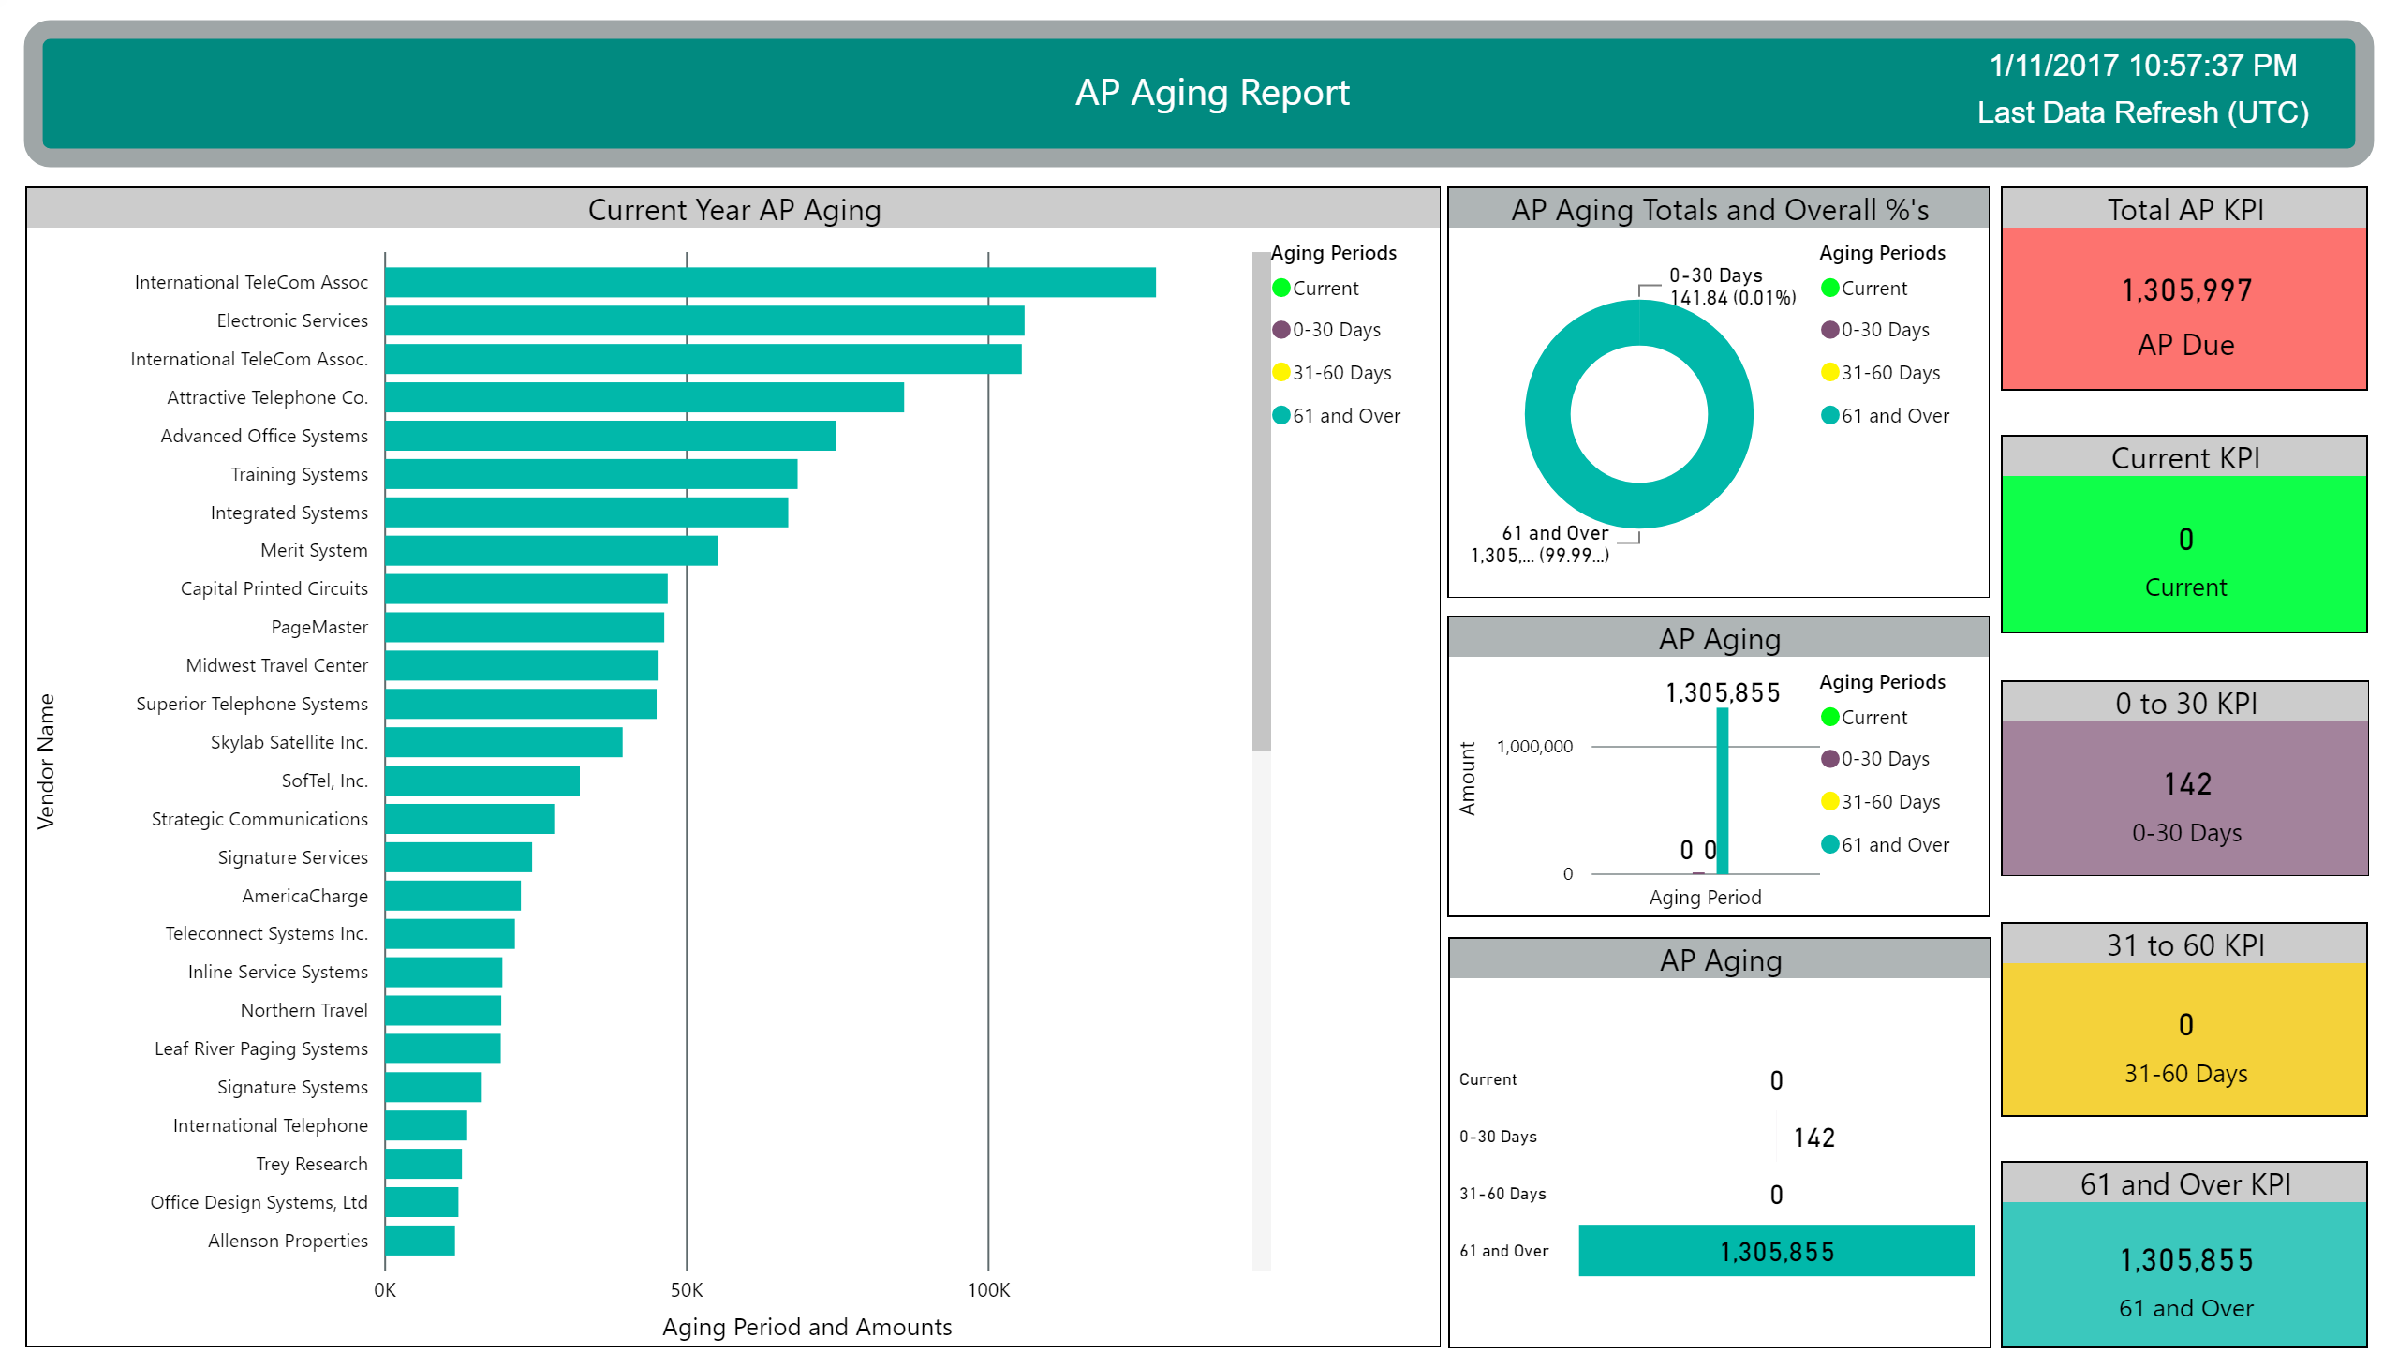

Slide 4
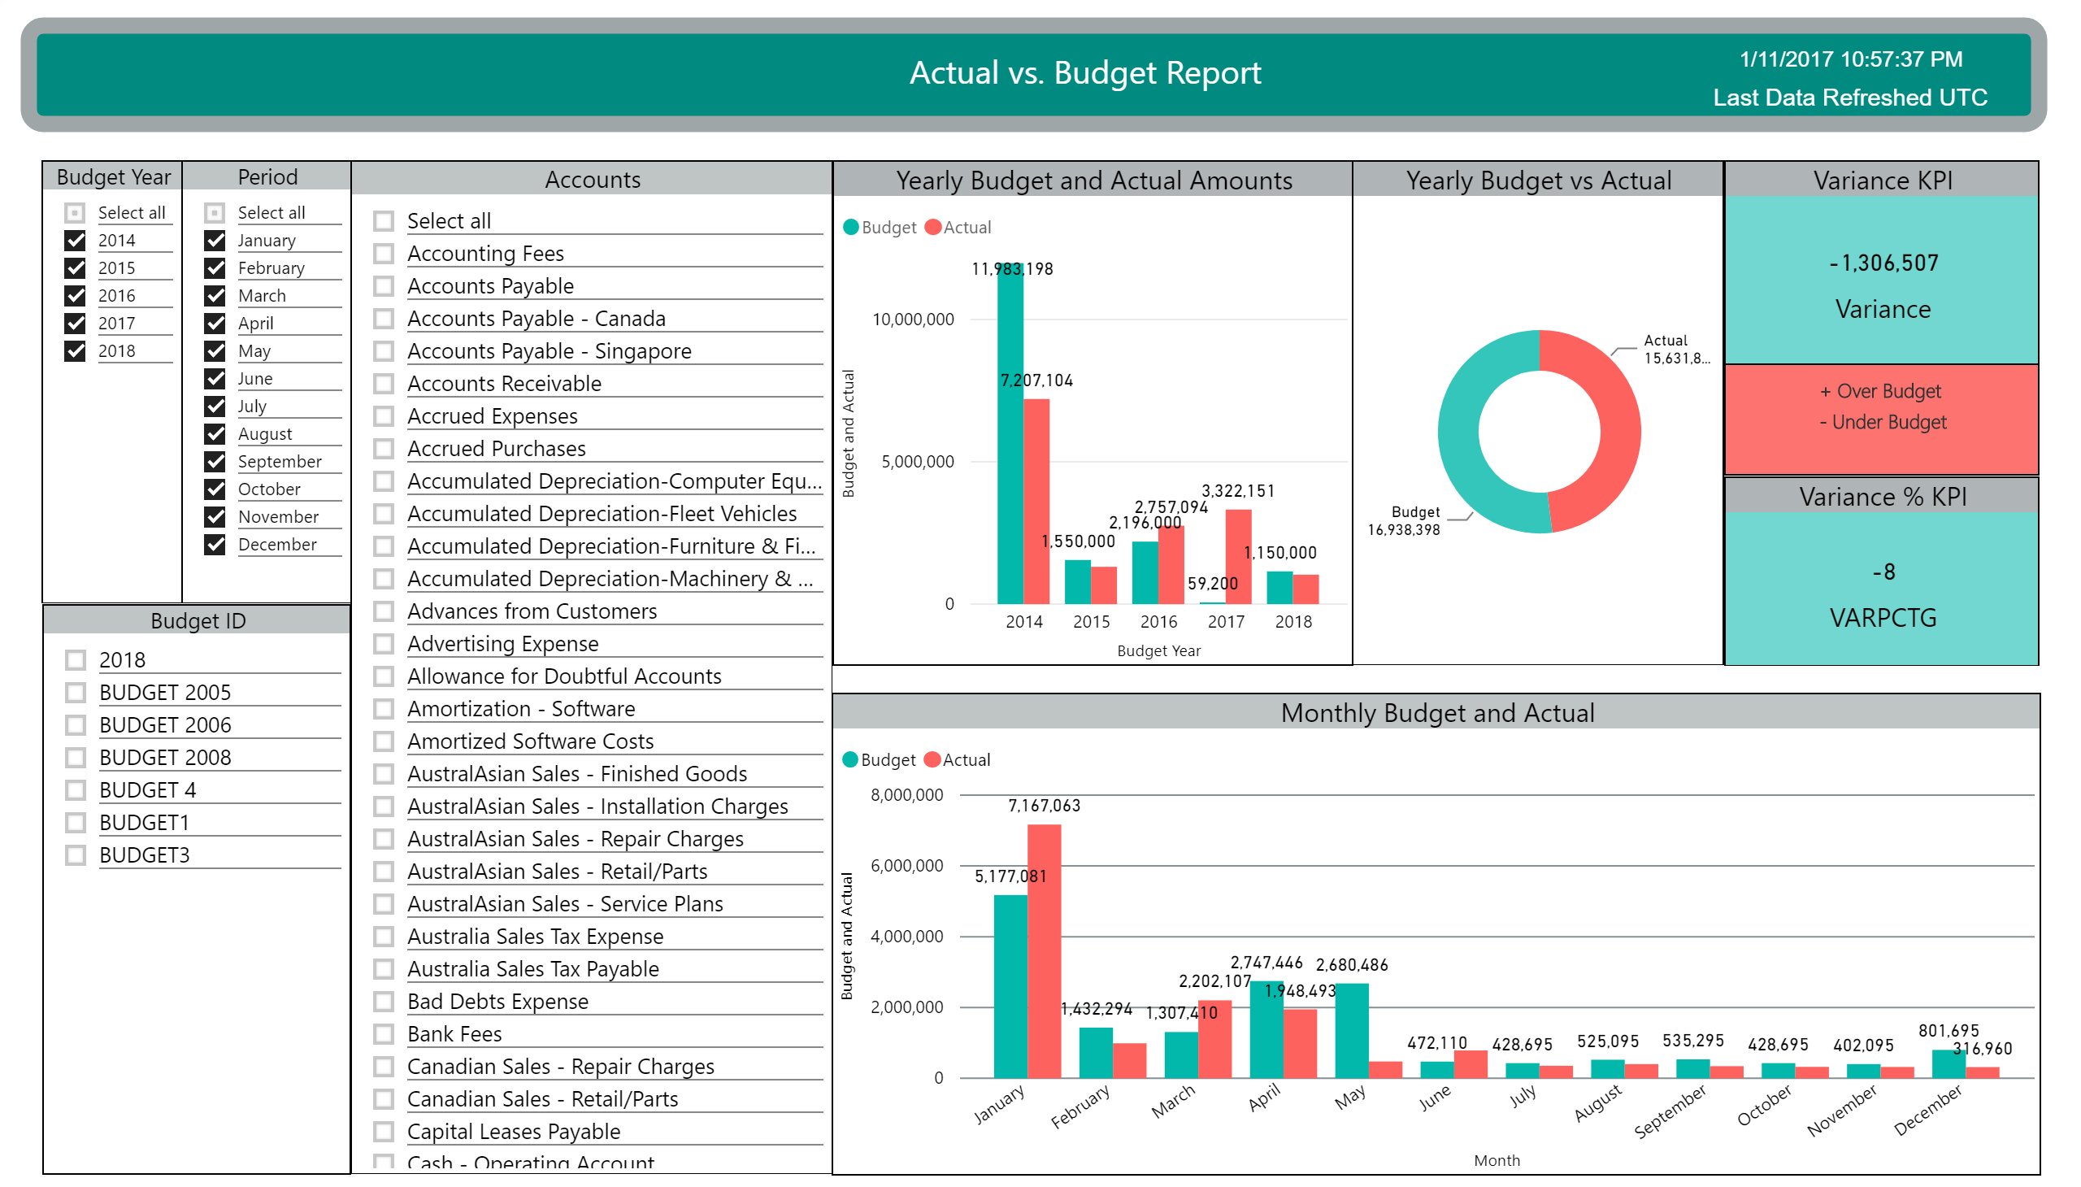

Slide 5
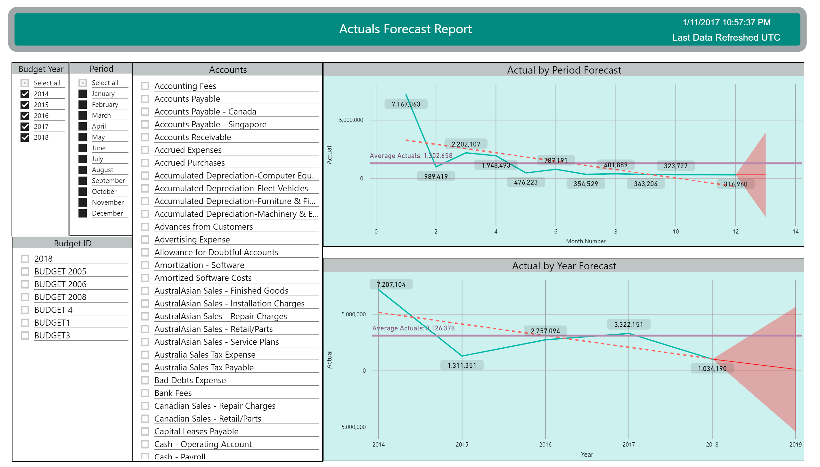

Slide 6
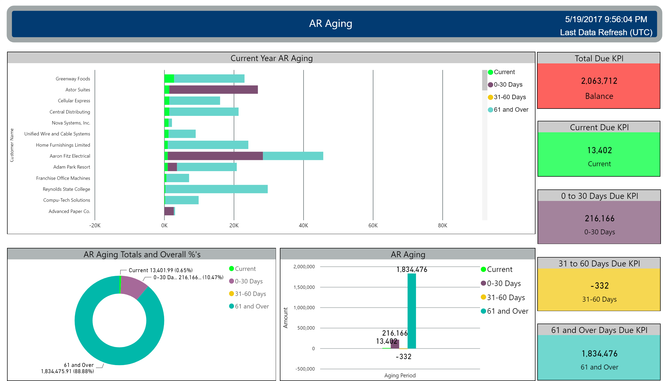

Slide 7
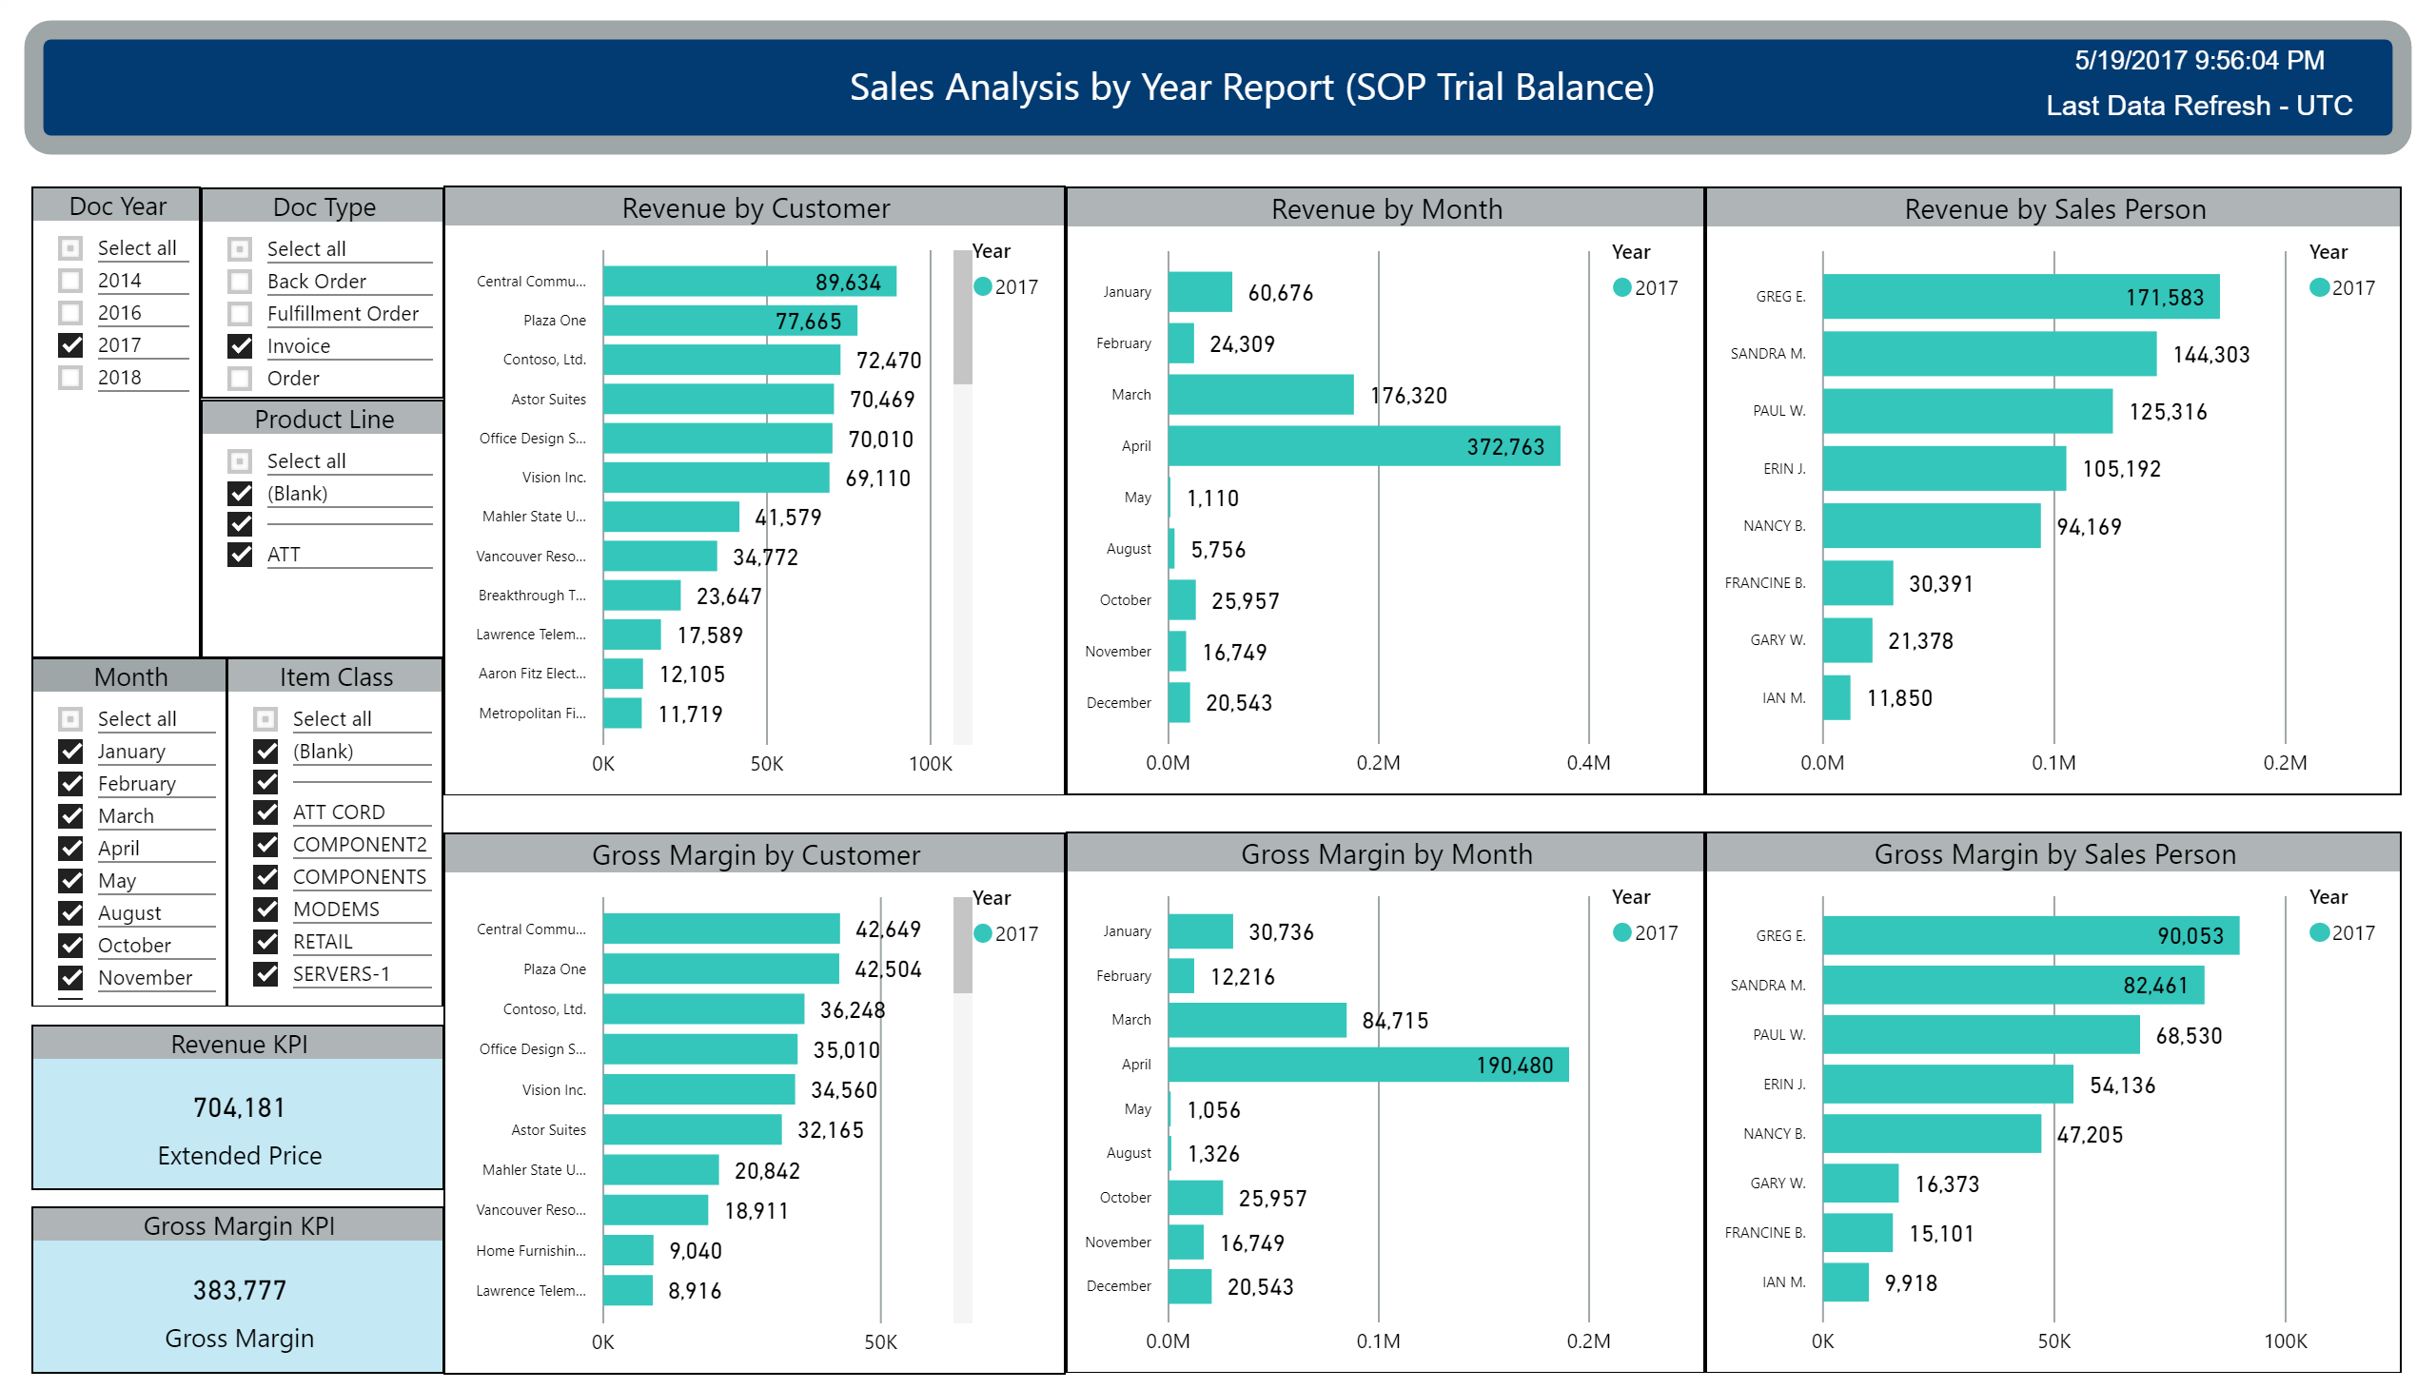

Slide 8
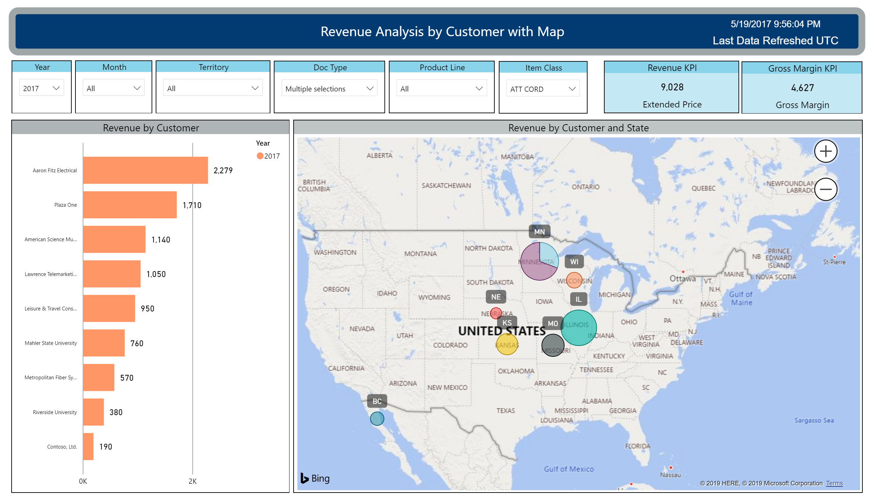

Slide 9
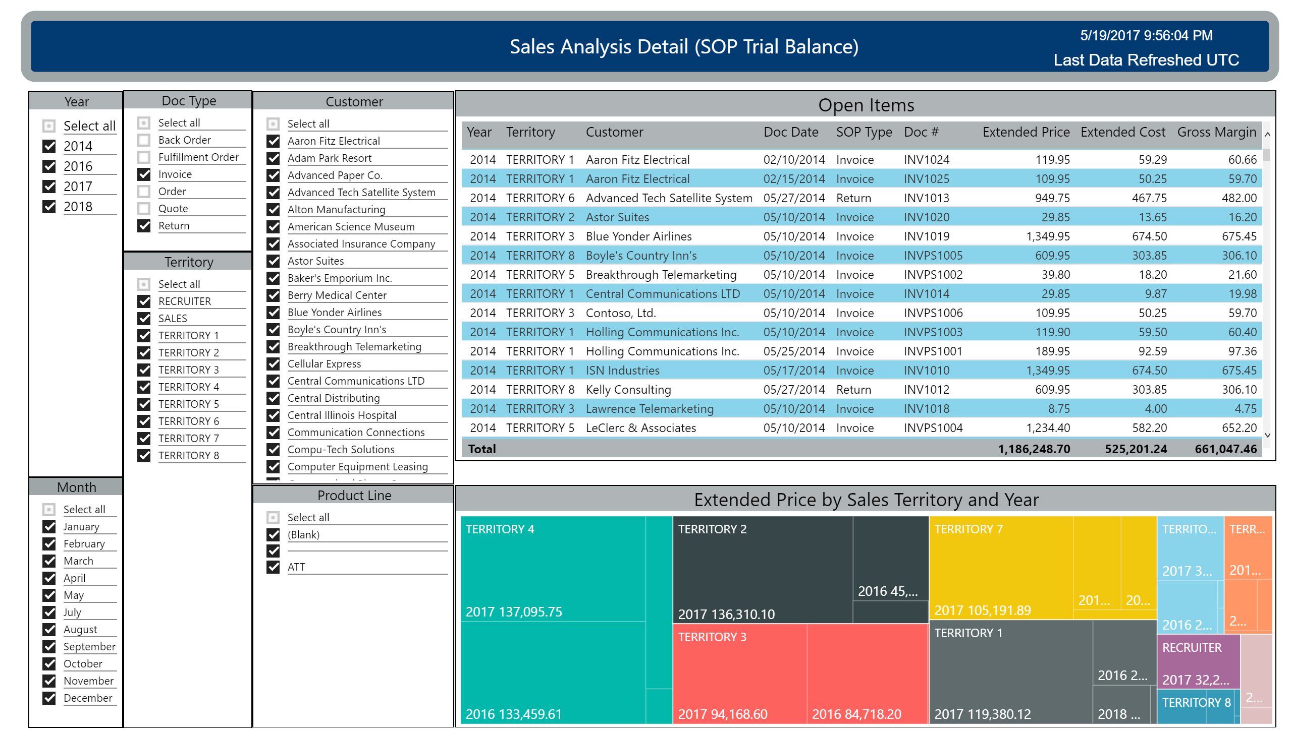

Slide 11
